Slide 1
Chap#4
Enterprise Systems and development lifecycle technology

Slide 2
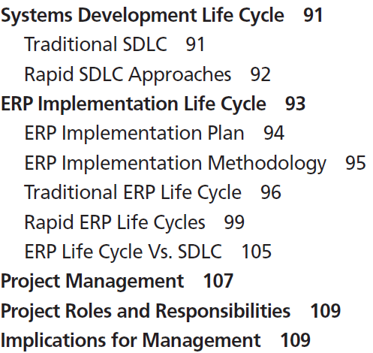
Overview

Slide 3
SYSTEMS DEVELOPMENT LIFE CYCLE
The process of developing new information systems is often called the system development life cycle.
Systematic process of planning, designing, and creating an information system for organizations.
SDLC uses a systems approach for problem solving that basically states that complex problems need to be broken up into smaller manageable problems using a systems’ hierarchy, and then developing a solution for each problem within the hierarchy.
It provides a structured top-down problem identification and bottom-up solution process for managing complex problems.
The SDLC process requires both technical and nontechnical problem-solving skills; therefore, the development team must understand technology, as well as the organization’s business processes, culture, and people.

Slide 4
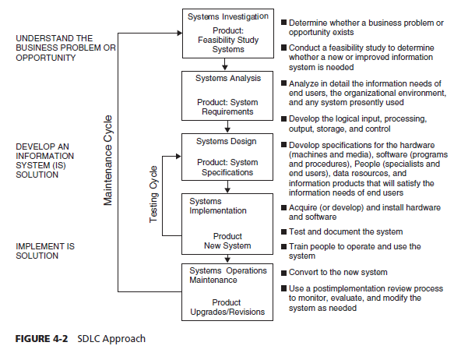
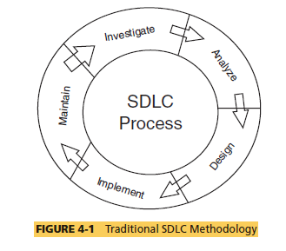
SDLC

Slide 5
Problems of SDLC
First, developing a new system is time consuming and tedious. In many cases the new system is outdated by the time it is developed.
Second, the cost associated with the SDLC process is very high. The cost of recruiting the development team and involving other members of the organization in the development process can be very expensive.
Finally, all information systems do not require such a rigorous(strict) SDLC process.

Slide 6
Rapid SDLC approaches
SDLC would be overkill for a small-scale decision-making application; therefore, over the years organizations have used rapid approaches to SDLC that are quicker and less expensive shortcuts to this process. These are called Rapid SDLC approaches.
One rapid development approach is prototyping it implements a skeleton or a prototype of the actual system with a focus on input (i.e., user interface) and output (i.e., screen displays and reports generated with dummy data).
The idea is to demonstrate the system functionality as soon as possible to the users and to get their feedback on the prototype.
This user-interactive systems because the prototype is eventually converted into a full-scale system.
In ERP implementations, many companies install a sandbox system to expose users to the system functionality.(prototyping)
Another rapid development approach is end-user development (EUD), which lets the end users create their own applications.
In this process the users are trained by the IT staff or professional trainers to develop customized applications using spreadsheets and Access Database.
EUD is applicable in ERP for designing custom reports from the ERP system.

Slide 7
ERP IMPLEMENTATION LIFE CYCLE
ERP applications are prepackaged software developed by commercial software vendors and custom installed for organizations to automate and integrate the various business processes. Although an ERP is packaged software.
These are complex software packages costing millions of dollars to develop and maintain that automate hundreds of business processes in an organization.
Furthermore, applications are mission critical (i.e., if they fail or break down, the organization will stop functioning).
ERP systems can be deployed in a big bang or phased approach , either of which initiates the stages of a system development life cycle.
Life cycle consists of four phases—adaptation(system investigation), acceptance(Approval), routinization (discipline(inline)), and infusion(maintenance or explore).

Slide 8
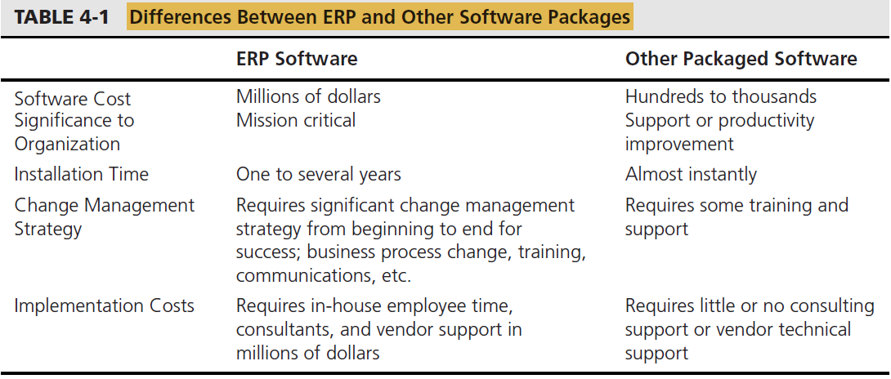
Differences between ERP and Other Software Packages
Notes:
Instantly (in less time)
Significant (More , Major)

Slide 9
ERP Implementation Plan
An ERP implementation plan is used to create a roadmap or blueprint to meet cost, scope, and time constraints of an implementation . The appropriateness of the plan depends, in part, on the project, the company, and the reasons for the implementation . Following are three major implementation plan choices:
Comprehensive : A comprehensive ERP integration plan is the most expensive, lengthy , and costly approach. It involves implementation of the full functionality of the ERP software in addition to industry-specific modules.
Middle of the Road : A middle-of-the-road ERP implementation plan involves some changes in the core ERP modules and a significant amount of BPR. The middle-of-the-road approach is not as expensive and nor as straightforward
Vanilla : A vanilla ERP implementation plan utilizes core ERP functionality and exploits the best practice business processes built into the software. A company following a vanilla implementation will have to simply align their business processes to the ERP system, rather than modify the software.

Slide 10
ERP Implementation Methodology
Methodology refers to a systematic approach to solving a business problem. ERP methodology builds on the theory that an enterprise can maximize its returns by maximizing the utilization of its fixed supply of resources.
ERP development life cycle when implementing ERP software in the changing but limited-resource organizational environment.
ERP life cycle accomplishes one stage at a time and requires formal milestone approvals prior to moving to the next stage. In a rapid ERP life cycle, once a company commits to the implementation, employees are empowered to make the decisions to keep the project moving forward and also rapid Corrections.

Slide 11
Traditional ERP Life Cycle
The traditional ERP life cycle includes the following major stages:
Stage 1. Scope and commitment stage : This is similar to the investigation stage in SDLC discussed earlier. In addition to conducting the feasibility study, however, one of the first steps is to develop a scope of ERP implementation within the resource and time requirement.
Stage 2. Analysis and design stage : In addition to analysis of user requirements, the ERP team has first to make a decision on the software and decide on consultants and SMEs(Small and mid-size enterprises).
Stage 3. Acquisition and development :The entire production platform must be configured and built with the necessary hardware, network, security, software, database, and real production data.
Stage 4. Implementation stage : The focus for this stage is on installing and releasing the system to the end users (i.e., “Go-Live”) and on monitoring the system release to the end users.
Stage 5. Operation stage : This is often managed by the operation team with assistance from the implementation team. Knowledge transfer is the major activity as support for the new system is migrated to the help desk and support staff.

Slide 12
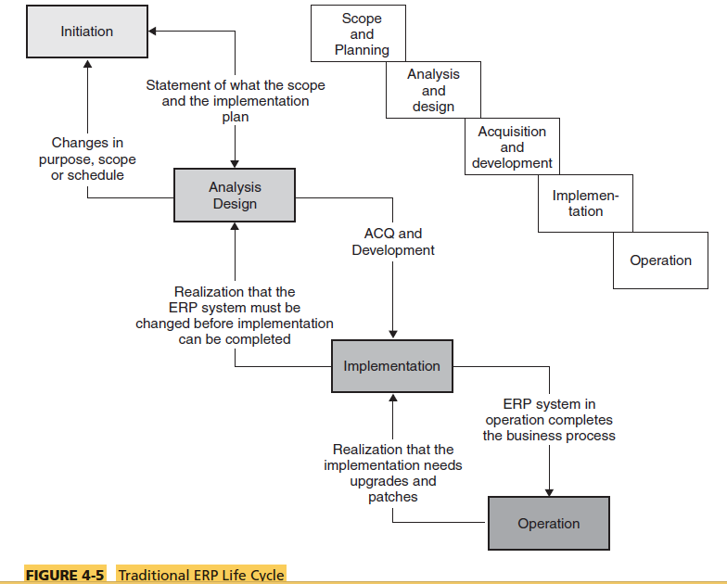
Diagram
Notes:
Scope chart from book (97)

Slide 13
Role of Change Management
Change management (CM) plays an important role throughout the ERP life cycle. System failures often occur when the attention is not devoted to this from the beginning stages. A vision for CM needs to be articulated from the first stage and then revised, monitored, and implemented on a constant basis.
Guide the implementation team on all the activities of change management, including guidance on what processes need changing, customization of business rules in ERP software, input screen design, report design, and training and communications plan for the end users affected by the new system.
Support of the top management as well as skills of the change management team are essential for successful implementation.

Slide 14
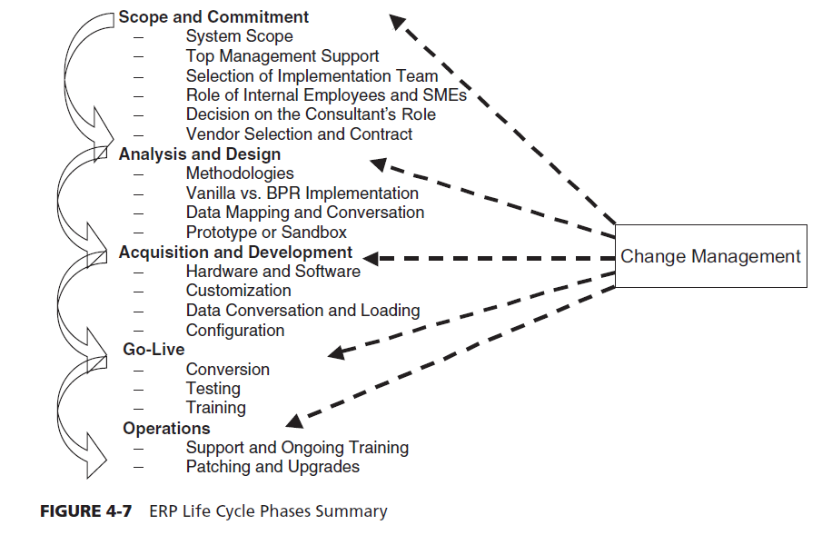
Diagram

Slide 15
Total Solution
Systematic way of approaching systems reengineering called the Total Solution. The Total Solution approach has five components:
The value proposition : The key decision to be made before any process can begin is to make sure that the ERP solution makes sound business sense.
Reality check : Assessing an organization’s readiness for change.
Aligned approach : Short-term as well as long-term benefits are equally important to any project’s success.
Success dimension : The key to any project’s success is having the right mix of people, skills, methods, and management (Team Work).
Delivering value : Measuring results and celebrating success.

Slide 16
FASTTRACK Approach
Designed to reflect and integrate decisions regarding business redesign, organizational change and performance, training , process and systems integrity, client–server technologies and technical architecture.
Stage 1. Scoping and planning: Project definition and scope. Project planning is initiated.
Stage 2. Visioning and targeting: Needs assessment. Vision and targets identified. As-is modeling.
Stage 3. Redesign: To-be Modeling. Software design and development.
Stage 4. Configuration: Software development. Integration test planning.
Stage 5. Testing and delivery: Integration testing. Business and system delivery

Slide 17
Rapid-Re Approach
ERP life cycle methodology called Rapid-Re. The five-stage, 54-step modular methodology is customized to the needs of each project because that is what happens in practice.
Stage 1. Preparation. Mobilize, organize, and energize the people who will perform the reengineering project.
Stage 2. Identification. Develop a customer-oriented process model of the business.
Stage 3. Vision. Select the processes to reengineer and formulate redesign options capable of achieving breakthrough performance.
Stage 4. Solution. Define the technical and social requirements for the new processes and develop detailed implementation plans.
Stage 5. Transformation. Implement the reengineering plans. In an ideal project, stages one and two consider all key processes within a company and conclude with a step that sets priorities for the processes to reengineer. The other stages are executed repeatedly for each process selected for reengineering.

Slide 18
ACCELERATED SAP (ASAP)
The ASAP roadmap is a detailed project plan by SAP that describes all activities in an implementation. Support technical project management, and addresses such concerns as interfaces, data conversions, and authorizations earlier than do most traditional implementations.
Phase 1.Project preparation -> Proper planning
Phase 2. Business blueprint -> The engineer delivers a complete toolkit of predefined business processes (business’ future state).
Phase 3.Realization -> Configuration and meet business processes.
Phase 4.Final preparation -> Adjustments
Phase 5. Go-live and support.

Slide 19
BUSINESS INTEGRATION METHODOLOGY (BIM)
To achieve business integration, a team must define and implement a comprehensive set of changes to an organization, spanning improvements to business processes , technology, and human performance, all aligned with an organization’s overall strategy. It is intended for use on medium to large projects that implement a full life cycle custom-built BI solution . Following are the phases:
The planning phase define appropriate strategies and approaches for achieving goals.
The delivering phase combination of human performance, business process, and technology that collectively creates value by improving business performance.
The managing phase This phase directs, coordinates, and monitors the activities
The operating phase This phase operates the new business capabilities that were created in the delivering phase to improve.

Slide 20
AGILE DEVELOPMENT Method
Agile methodologies start with smaller sets of requirements, they start small and deliver functionality incrementally in a series of releases.
Users will be able to provide feedback quickly on how this system meets their needs.
If a requirement is missing or wrong, it can be corrected quickly rather than requiring a long and expensive process.
Waterfall Model implementation, if the first requirement implemented is wrong, an entire ERP system could be implemented upon that basis.
An agile methodology has many different types of implementations. Two of the most popular implementations are Scrum and extreme programming (XP).
In Scrum, the methodology states the following: “Instead of providing complete, detailed descriptions of how everything is to be done on the project, much is left up to the team. This is done because the team will know best how to solve its problem.”
Extreme Programming (XP) is successful because it stresses customer satisfaction . It gives working software to the customers quickly and incorporates their feedback quickly to build the best product possible.

Slide 21
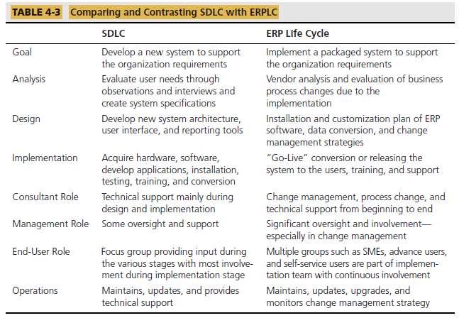
ERP Life Cycle Vs. SDLC

Slide 22
Roles of ERP Implementation
From Book (Pg 110)

